Slide 1



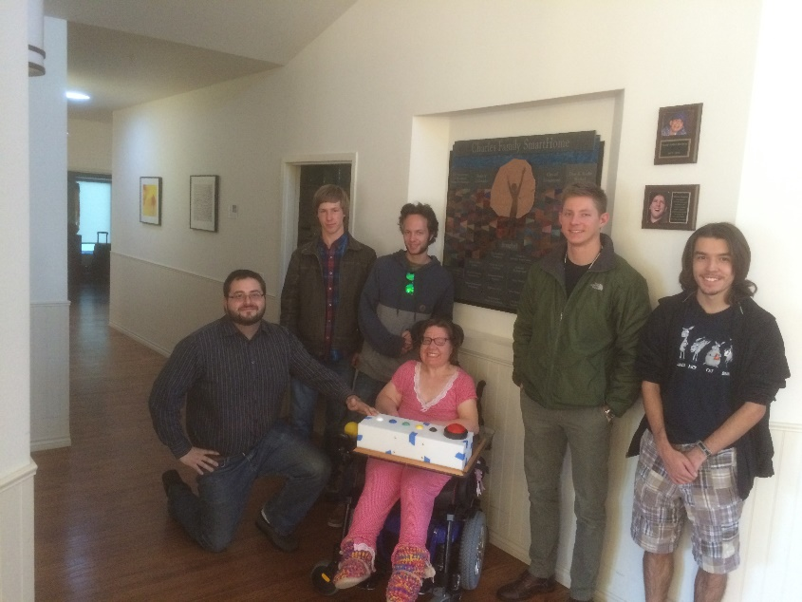
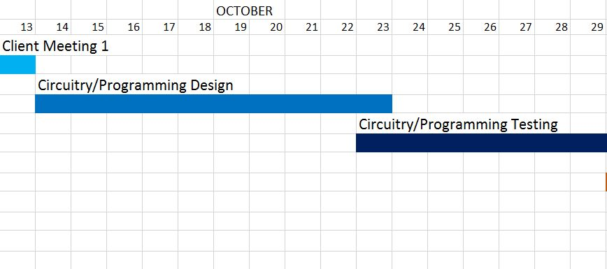
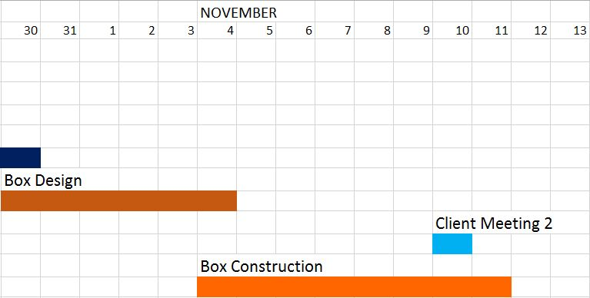
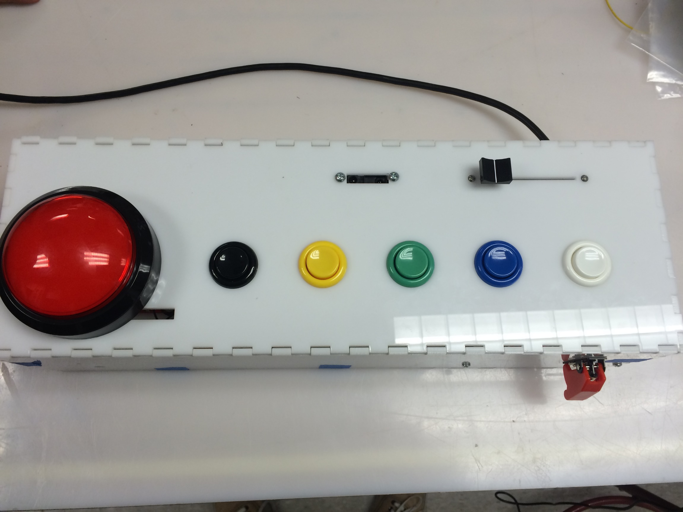
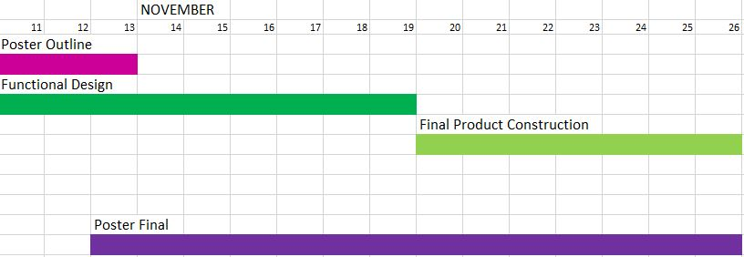
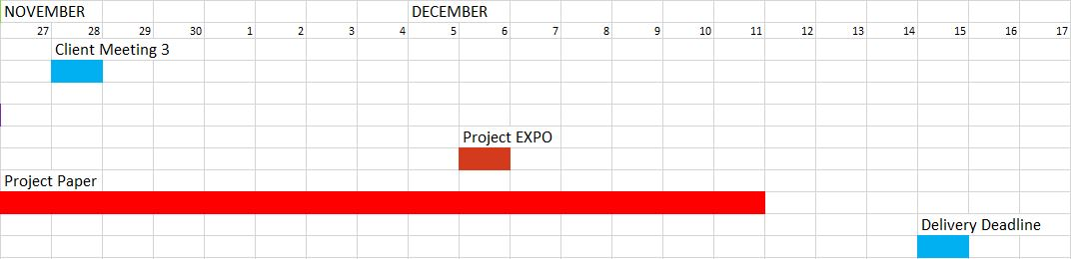
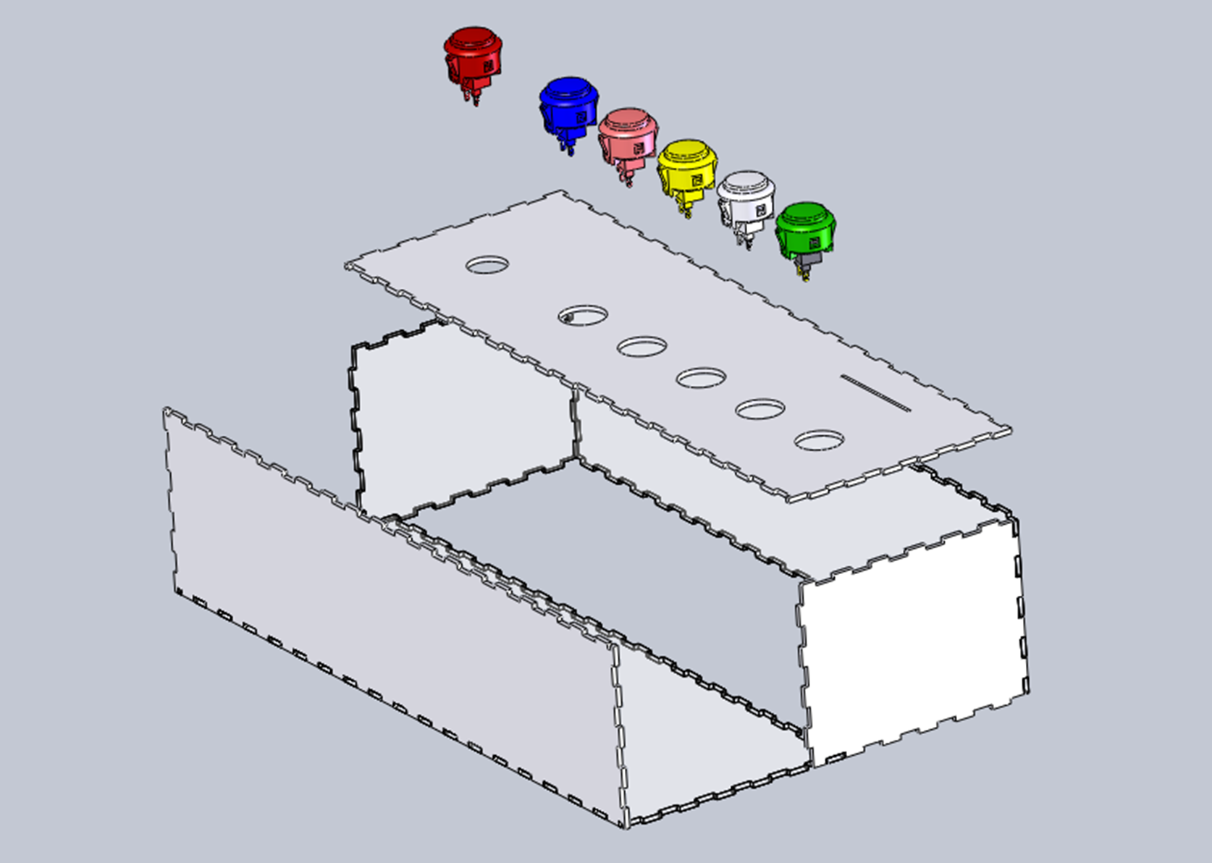
TABLE Nine
GEEN 1400-50 Piket-May
Design Process:
MACMIO
Our Client:
Circuitry
Stacey is our client at Imagine! CO. She lives in the Longmont SmartHome and loves music, so we are making a device which will let her play along to her favorite songs.
MIDI and Audio Control with Multiple Input and Output
Abstract:
The purpose of our project is to create an easy-to-use music player to be implemented in the Longmont SmartHome. It will allow the residents there to both listen to and play along with their favorite music, encouraging creativity and fun.
The MACMIO will be able to produce sounds using a synthesizer code called Mozzi. It will also be able to send MIDI signals to a computer which can be easily modified to make different effects.
LED Strip
Button Panel
Proximity Sensor
Slider
Timeline
Power Supply 12 Volt
Mozzi Arduino
MIDI Arduino
MP3 Trigger
This proximity sensor uses a servo to change to volume of all sounds.
9 Volt Regulator
Audio Mixer
Midi
Servo
MIDI to USB
Power
Circuit Connections
Coding
This slider changes MIDI sound effects.
Slider
Computer
Proximity Sensor
We have two sets of code- one for each Arduino. One exclusively controls Mozzi. The other handles MIDI signals (including the slider) as well as volume.
This missile switch turns on the box.
Non-Mozzi Redboard
Materials and Budget
Big Button
Small Buttons
Mp3 Trigger
Mozzi Redboard
This large button will cycle through 5 songs.
Using the MACMIO
Boards | $101.33
Control Surfaces | $36.50
Servo Apparatus | $41.64
Power Supply | $46.95
Mixer | $22.39
Acrylic | $25.95
Misc. Costs | $87.18
Total | $361.94
External Speaker
Mozzi
We needed to produce sounds directly from the Arduino processor. After research, we found a library of synthesizer effects for Arduino called “Mozzi.” We picked effects that we liked and modified their code to actuate with a button.
These small buttons play sound effects.
MIDI
“MIDI” is the name of a protocol which is used for music. Components can be programmed to send MIDI to a computer. The computer can then use a program such as Audacity or Garageband to take those signals and turn them into sounds.
Packaging
How it Works:
This is how the box was assembled. We used a laser-cutter to make teeth as well as the holes for the various controls. Inside, the different boards and controls were bolted in. There is an access panel on the bottom for changing out the SD card.
Plays 5 songs from an SD card
Allows the user to play sound effects over the music
5 buttons for sound effects and a slider to change the pitch of the effects
Volume is controlled with a proximity sensor
Sound effects can be produced by connecting the box to speakers or by connecting to a computer
Uses two Arduino Redboards and an Mp3 Trigger
Circuitry array is connected to a 12 volt power supply.
Acknowledgements: We would like to thank Tim May and Doug Walter for helping us with our circuitry. We also want to thank our TAs: Madison and Katelyn.

